Slide 1
Zygo Software개발
2026.01.13
신 용 대

Slide 2
목차
Zygo Class
Zygo제어를 위한 Packet설계

Slide 3
Zygo Class
2026.01.13
신 용 대

Slide 4
Remote Access with DLL
MxClient Class Class : 1
Core Class Class : 2
Enumerations Class : 3
MxService Class Class : 4
InstrumentService Class Class : 5
MasksService Class Class : 6
FiducialsServiceClass Class : 7
MotionService Class Class : 8
PatternService Class Class : 9
RecipeService Class Class : 10
SystemCommandsService Class Class : 11
UserInterfaceService Class Class : 12
UserFunctionService Class Class : 13 (Only use GigaVis)

Slide 5
MxClient Class (Class : 1)
Client Initialization Group : 1
Client Connection Group : 2
Client Termination Group : 3
Service Class Members Group : 4

Slide 6
MxClient Class (Class : 1)
Client Initialization (Group : 1)
public MxClient(); (Item : 1)
Initializes a new instance of the MxClient class using the host "localhost“
public MxClient(string host); (Item : 2)
The hostname or IP address of the remote Mx server
Client Connection (Group : 2)
public void Connect(bool forceIfActive); (Item : 1)
If true, forces Mx to terminate any existing connection prior to establishing this one
public bool Connected; (Item : 2)
Returns true if connected to Mx, false otherwise
Client Termination (Group : 3)
public void Terminate(); (Item : 1)
Terminates the remote connection to Mx

Slide 7
MxClient Class (Class : 1)
Service Class Members (Group : 4)
public MxService Mx; (Item : 1)
The MxService instance associated with this client
public InstrumentService Instrument; (Item : 2)
The InstrumentService instance associated with this client
public MasksService Masks; (Item : 3)
The MasksService instance associated with this client
public MotionService Motion; (Item : 4)
The MotionService instance associated with this client
public PatternService Pattern; (Item : 5)
The PatternService instance associated with this client
public RecipeService Recipe; (Item : 6)
The RecipeService instance associated with this client
public SystemCommandsService SystemCommands; (Item : 7)
The SystemCommandsService instance associated with this client
public UserInterfaceService UserInterface; (Item : 8)
The UserInterfaceService instance associated with this client

Slide 8
Core Class (Class : 2)
ZygoError Class
public class ZygoError : Exception
public ZygoError();
public ZygoError(string message);
public ZygoError(string message, Exception inner);
Point2D Class
public class Point2D
public double x;
public double y;
public Point2D(double x, double y);

Slide 9
Enumerations (Class : 3)
Unit Enum
public enum Unit
AxisType Enum
public enum AxisType
FileTypes Enum
public enum FileTypes
AlignViewMode Enum
public enum AlignViewMode
RingSpotMode Enum
public enum RingSpotMode
SequenceOperation Enum
public enum AxisType
DialogMode Enum
public enum DialogMode
DmiStatus Enum
public enum DmiStatus

Slide 10
MxService Class (Class : 4)
Application Methods
Settings Methods
Data Methods
Results, Attributes, and Controls Methods
Other Results Methods
Data Matrix Methods
Annotations Grid Methods
Logging Methods
Script Methods
User Defined Waves Methods
Auto Save Methods
Auto Sequence Methods

Slide 11
MxService Class (Class : 4)
Application Methods
public bool IsApplicationOpen();
public string GetApplicationPath();
public void OpenApplication(string fileName);
public void CloseApplication();
public void SaveApplicationAs(string fileName);
public void LoadSettings(string fileName);
public void SaveSettings(string fileName);

Slide 12
MxService Class (Class : 4)
Settings Methods
public void LoadSettings(string fileName);
public void SaveSettings(string fileName);
Data Methods
public void Analyze();
public void LoadData(string fileName);
public void SaveData(string fileName);
public void LoadSignalData(string fileName);
public void SaveSignalData(string fileName);
public void ResetData();

Slide 13
MxService Class (Class : 4)
Results, Attributes, and Controls Methods
public double GetAttributeNumber(string[] path, Unit units);
public double GetAttributeNumber(string[] path, string units);
public string GetAttributeString(string[] path);
public double GetControlNumber(string[] path, Unit units);
public double GetControlNumber(string[] path, string units);
public string GetControlString(string[] path);
public bool GetControlBool(string[] path);
public double GetResultNumber(string[] path, Unit units);
public double GetResultNumber(string[] path, string units);
public string GetResultString(string[] path);
public void SetControlNumber(string[] path, double numberValue, Unit units);
public void SetControlNumber(string[] path, double numberValue, string units);
public void SetControlString(string[] path, string stringValue);
public void SetControlBool(string[] path, bool value);
public void SetResultNumber(string[] path, double numberValue, Unit units);
public void SetResultNumber(string[] path, double numberValue, string units);
public void SetResultString(string[] path, string stringValue);

Slide 14
MxService Class (Class : 4)
Other Results Methods
public void ClearProcessStats();
public void StoreProcessStats();
public void LogReports();

Slide 15
MxService Class (Class : 4)
Data Matrix Methods
public double GetDataCenterX(Control control, Unit units);
public double GetDataCenterX(Control control, string units);
public double GetDataCenterY(Control control, Unit units);
public double GetDataCenterY(Control control, string units);
public double GetDataOriginX(Control control, Unit units);
public double GetDataOriginX(Control control, string units);
public double GetDataOriginY(Control control, Unit units);
public double GetDataOriginY(Control control, string units);
public double GetDataSizeX(Control control, Unit units);
public double GetDataSizeX(Control control, string units);
public double GetDataSizeY(Control control, Unit units);
public double GetDataSizeY(Control control, string units);

Slide 16
MxService Class (Class : 4)
Annotations Grid Methods
public void CreateAnnotation(string annotationLabel, string annotationValue);
public void DeleteAnnotation(string[] path);
public void SetAnnotation(string[] path, string value);
public string GetAnnotation(string[] path);
Logging Methods
public void LogInfo(string message);
public void LogError(string message);
public void LogFatal(string message);
Script Methods
public void RunScript(string fileName);

Slide 17
MxService Class (Class : 4)
User Defined Waves Methods
public void SetUserDefinedWaves(double valueToSet);
Auto Save Methods
public bool GetAutoSaveDataStatus();
public void SetAutoSaveDataStatus(bool status);
Auto Sequence Methods
public void StartSequence(int count)
public void AutoSequence(SequenceOperation sequenceOperation, int startDelay, int interval, string scriptName)

Slide 18
InstrumentService Class (Class : 5)
Align-View Mode Methods
Ring-Spot Mode Methods
Acquisition Methods
Asynchronous Acquisition Methods
Optimization Methods
Turret Methods
Zoom Methods
Light Level Methods
Wand Status Method
Camera Information Methods
Instrument Hardware Methods
MST Methods
DMI Methods
DynaPhase Methods

Slide 19
InstrumentService Class (Class : 5)
Align-View Mode Methods
public AlignViewMode GetAlignViewMode();
public void SetAlignViewMode(AlignViewMode mode);
Ring-Spot Mode Methods
public RingSpotMode GetRingSpotMode();
public void SetRingSpotMode(RingSpotMode mode);
Acquisition Methods
public string Acquire(bool wait = true);
public string Measure(bool wait = true);
public int[][] AcquireFrame(int align_view);
public AcquireFrame(int align_view);

Slide 20
InstrumentService Class (Class : 5)
Asynchronous Acquisition Methods
public bool IsFrameGrabComplete(string taskId);
public void WaitForFrameGrabComplete(string taskId, double timeout);
public bool IsAcquisitionComplete(string taskId);
public void WaitForAcquisitionComplete(string taskId, double timeout);
public bool IsMeasureComplete(string taskId);
public void WaitForMeasureComplete(string taskId, double timeout);

Slide 21
InstrumentService Class (Class : 5)
Optimization Methods
public void AutoFocus();
public void AutoTilt();
public void AutoFocusTilt();
public void AutoLightLevel();
public void AutoLateralCalibration(double length, Unit units);
public void AutoCenter();
Turret Methods
public int GetTurret();
public void MoveTurret(int position);

Slide 22
InstrumentService Class (Class : 5)
Zoom Methods
public double GetZoom();
public void SetZoom(double zoom);
public double GetMaximumZoom();
public double GetMinimumZoom();
public void LockZoom();
public void UnlockZoom();
Light Level Methods
public double GetLightLevel();
public void SetLightLevel(double lightLevel);

Slide 23
InstrumentService Class (Class : 5)
Wand Status Method
public void SetWandEnabled(bool enabled);
Camera Information Methods
public double GetCameraResolution(Unit units);
public double GetCameraResolution(string units);
public double GetCameraSizeX(Unit units);
public double GetCameraSizeX(string units);
public double GetCameraSizeY(Unit units);
public double GetCameraSizeY(string units);
public void SetCameraResolution(double value, string units);

Slide 24
InstrumentService Class (Class : 5)
Instrument Hardware Methods
public void SetSleepModeEnabled(bool enabled);
public void GetSystemTypeName();
public int ReadSdoInt8(byte nodeid, int index, int subindex);
public void WriteSdoInt8(byte nodeid, int index, int subindex, int val);
public int ReadSdoInt16(byte nodeid, int index, int subindex);
public void WriteSdoInt16(byte nodeid, int index, int subindex, int val);
public int ReadSdoInt32(byte nodeid, int index, int subindex);
public void WriteSdoInt32(byte nodeid, int index, int subindex, int val);
public float ReadSdoReal32(byte nodeid, int index, int subindex);
public void WriteSdoReal32(byte nodeid, int index, int subindex, float val);
public double ReadSdoReal64(byte nodeid, int index, int subindex);
public void WriteSdoReal64(byte nodeid, int index, int subindex, double val);
public string ReadSdoStr(byte nodeid, int index, int subindex);
public void WriteSdoStr(byte nodeid, int index, int subindex, string val);

Slide 25
InstrumentService Class (Class : 5)
MST Methods
public void CalculateGeometry();
public void CalculateHomogeneity();
DMI Methods
public bool IsDmiActive();
public DmiStatus GetDmiStatus();
public double GetDmiPosition(string units);
public void ResetDmi();

Slide 26
InstrumentService Class (Class : 5)
DynaPhase Methods
public bool IsCalibrationRequired;
public bool IsWizardActive;
public DynaPhaseSingle DynaPhaseSingle;
public DynaPhaseProduction DynaPhaseProduction;
public DynaPhaseMovie DynaPhaseMovie;
public System.Drawing.Bitmap CurrentWizardImage;
public string PromptText;
public void Start();
public void Next();
public void Cancel();
public System.Drawing.Bitmap CurrentWizardImage;
public string PromptText;
public void Start();
public void Next();
public void AbortMeasurement()
public void Initialize();
public void StartRecording();
public void Stop();
public void AbortRecording();
public System.Drawing.Bitmap CurrentWizardImage;
public string PromptText;
public void Shutdown();
public string[] GetAvailableMovieTypes();
public string[] GetAvailableTriggers();
public string[] GetAvailableSampleTypes();
public int Frames;
public int CameraRate;
public string TriggerType;
public int TriggerDelay;
public string MovieFolder;
public string MovieType;
public string MovieName;
public string SampleType;
public double SampleTime;
public int MovieFileRate;

Slide 27
MasksService Class (Class : 6)
Base Class
public Masks GetMasks();
public double GetRotation(string maskId, string units);
Mask Class
Masks Class

Slide 28
MasksService Class (Class : 6)
Mask Class
public void MoveAbsolute(double x, double y, Unit unit = Unit.Pixels);
public void MoveRelative(double x, double y, Unit unit = Unit.Pixels);
public void Resize(double height, double width, Unit unit = Unit.Pixels);
public void Rotate(double angle, Unit units);
public Point2D Center;
public Point2D GetCenter(Unit units = Unit.Pixels)
public double Height;
public double GetHeight(Unit units = Unit.Pixels)
public double Width;
public double GetWidth(Unit units = Unit.Pixels)
public string Type;

Slide 29
MasksService Class (Class : 6)
Masks Class
public void Clear(string maskType = null);
public void Delete(Mask mask);
public Mask GetMaskClosestTo(double x, double y, string maskType = null, Unit unit=Unit.Pixels);
public int GetNumMasks(string maskType = null);
public void Load(string fileName);
public void Save(string fileName);

Slide 30
FiducialsServiceClass (Class : 7)
Fiducial Class
Fiducials Class

Slide 31
FiducialsServiceClass (Class : 7)
Fiducial Class
public void MoveAbsolute(double x, double y, Unit unit = Unit.Pixels);
public void MoveRelative(double x, double y, Unit unit = Unit.Pixels);
public void Resize(double height, double width, Unit unit = Unit.Pixels);
public void Rotate(double angle, Unit units);
public Point2D Center;
public Point2D GetCenter(Unit unit = Unit.Pixels);
public double Height;
public double GetHeight(Unit unit = Unit.Pixels);
public double Width;
public double GetWidth(Unit unit = Unit.Pixels);
public string Type;

Slide 32
FiducialsServiceClass (Class : 7)
Fiducials Class
public int GetNumSets()
public void AddSet()
public void Delete(Fiducial fiducial);
public void ClearSet(int fiducialSet=0);
public void DeleteSet(int fiducialSet=0);
public Fiducial GetFiducialClosestTo(double x, double y, int workingSet=0, Unit units = Unit.Pixels);
public int GetNumFiducials(int workingSet = null);
public void Load(string fileName);
public void Save(string fileName);

Slide 33
MotionService Class (Class : 8)
Home Axes Methods
Move Axes Methods
Retrieve Current Position Methods
Wait On Axes Methods
Axis Availability Methods
Pendant Status Method
Z-Stop Status Method

Slide 34
MotionService Class (Class : 8)
Home Axes Methods
public string Home(AxisType[] axes, bool wait);
public bool IsHomed(AxisType axis);
Move Axes Methods
public string MoveX(double xPosition, Unit unit, bool wait);
public string MoveX(double xPosition, string unit, bool wait);
public string MoveY(double yPosition, Unit unit, bool wait);
public string MoveY(double yPosition, string unit, bool wait);
public string MoveZ(double zPosition, Unit unit, bool wait);
public string MoveZ(double zPosition, string unit, bool wait);
public string MoveXY(double xPosition, double yPosition, Unit unit, bool wait);
public string MoveXY(double xPosition, double yPosition, string unit, bool wait);
public string MoveXYZ(double xPosition, double yPosition, double zPosition, Unit unit, bool wait);
public string MoveXYZ(double xPosition, double yPosition, double zPosition, string unit, bool wait);
public string MoveP(double pPosition, Unit unit, bool wait, bool isParcentric=false);
public string MoveP(double pPosition, string unit, bool wait, bool isParcentric=false);
public string MoveR(double rPosition, Unit unit, bool wait, bool isParcentric=false);
public string MoveR(double rPosition, string unit, bool wait, bool isParcentric=false);
public string MoveRP(double rPosition, double pPosition, Unit unit, bool wait, bool isParcentric=false);
public string MoveRP(double rPosition, double pPosition, string unit, bool wait, bool isParcentric=false);
public string MoveT(double tPosition, Unit unit, bool wait);
public string MoveT(double tPosition, string unit, bool wait);

Slide 35
MotionService Class (Class : 8)
Retrieve Current Position Methods
public double GetXPos(Unit unit);
public double GetXPos(string unit);
public double GetYPos(Unit unit);
public double GetYPos(string unit);
public double GetZPos(Unit unit);
public double GetZPos(string unit);
public double GetPPos(Unit unit);
public double GetPPos(string unit);
public double GetRPos(Unit unit);
public double GetRPos(string unit);
public double GetTPos(Unit unit);
public double GetTPos(string unit);

Slide 36
MotionService Class (Class : 8)
Wait On Axes Methods
public void Wait(AxisType[] axes, double timeout);
public void WaitForStageTaskComplete(string taskId, double timeout);
Axis Availability Methods
public bool IsActive(AxisType axis);
Pendant Status Method
public void SetPendantEnabled(bool enabled);
Z-Stop Status Method
public bool IsZStopSet();

Slide 37
PatternService Class (Class : 9)
Save/Load Pattern Methods
public void Load(string fileName);
public void Save(string fileName);
Run Pattern Methods
public void Align();
public void PreAlign();
public void Run();

Slide 38
RecipeService Class (Class : 10)
Save/Load Recipe Methods
public void Load(string fileName);
public void Save(string fileName);
Run Recipe Method
public void Run();

Slide 39
SystemCommandsService Class (Class : 11)
Host Information Methods
public string GetComputerName();
public string GetOSName();
public long GetRamSize();
Directory Information Methods
public string GetBinDir();
public string GetWorkingDir();
public string GetOpenDir(FileTypes fileType);
public void SetOpenDir(FileTypes fileType, string dirPath);
public string GetSaveDir(FileTypes fileType);
public void SetSaveDir(FileTypes fileType, string dirPath);

Slide 40
UserInterfaceService Class (Class : 12)
Mx GUI Component
Modal Dialogs
Toolbar Click Methods
Image Grid Method
Tab Class Method
Navigator Class
DockPanel Class
Group Class
Container Class
ContainerWindow Class
Window Class
Control Class
Saving Control Data
Print Methods
Plot Methods
Sequence Method

Slide 41
UserInterfaceService Class (Class : 12)
Mx GUI Components
Modal Dialogs
public bool ShowDialog(string text, DialogMode mode);
public string ShowInputDialog(string text, string defaultValue, Dialog-Mode mode, int maxLength);
public void ShowTimedDialog(string text, DialogMode mode, int seconds);
Toolbar Click Methods
public void ClickToolbarButton(string[] buttonPath);
Image Grid Method
public void SetImageGrid(Control control, string imagePath);
Tab Class Method
public Tab GetTab(string name);
public List<Tab> GetTabs();
public DockPanel GetDockPanel(string name);
public Group GetGroup(string name);
public void Show();
public string Name;
public Navigator Navigator;
public List<DockPanel> DockPanels;
public List<Group> Groups;

Slide 42
UserInterfaceService Class (Class : 12)
Navigator Class
public void Pin(bool doPin);
DockPanel Class
public void Pin(bool doPin);
public string Name;
Group Class
public Container GetContainer(string containerName);
public string Name;
public List<Container> Containers;
Container Class
public void Show();
public string Name;
public List<Control> Controls;

Slide 43
UserInterfaceService Class (Class : 12)
ContainerWindow Class
public void Show();
public void Close();
public void ToFront();
public void ToBack();
public string Name;
public bool Open;
public List<Control> Controls;

Slide 44
UserInterfaceService Class (Class : 12)
Window Class
public Window ShowMaskEditor();
public Window ShowFiducialEditor();
public void Close();
public void SaveData(string filePath);
public void SaveImage(string filePath);
public void ToBack();
public void ToFront();
public string Name;
public bool Open;
public List<Control> Controls;
public void SetChartLimits(string controlId, string axis, double low, double high, string unit);
public void SetChartLimits(string controlId, string axis, double low, double high, string unit);
public void ClearChartLimits(string controlId, string axis, string limit);

Slide 45
UserInterfaceService Class (Class : 12)
Control Class
public Control GetControl(string[] path);
public void SaveData(string filePath, ISaveDataParameters saveDataParameters = null);
public void SaveImage(string filePath);
public string Name;
public List<Control> Controls;
Saving Control Data
public bool SimpleMode;
public bool StandardFormat;
public string CodeVTitle;
public string CodeVType;
public string CodeVComment;
public string SdfManufacturer;
public DateTime SdfCreateDate;
public DateTime SdfModificationDate;
public double SdfWavelength;
public string SdfDataType;

Slide 46
UserInterfaceService Class (Class : 12)
Print Methods
public void PrintMainWindow(int typeOfPrint, string path);
Plot Methods
public void SetPlotPaletteScale(string controlId, string scaleMode, double peak, double valley, string unit);
public void SetPlotPaletteScale(string controlId, string scaleMode, double peak, double valley, string unit);
public void SetPlotPalette(string controlId, string paletteName);
Sequence Method
public void SetSequenceStepState(string sequenceId, string sequenceStepDesc, bool onOff);

Slide 47
UserFunctionService Class (Class : 12)
Spare …

Slide 48
Zygo제어를 위한 Packet설계
2026.01.13
신 용 대

Slide 49
기존에 사용된 Packet 구조
Header[1]
packetData[?]
1
Header의 값에 따라 정해진 데이터 구조
[byte]

Slide 50
기존에 사용된 packetData
Header 의 값에 따라 변경
case 0://분류 0(Turret Setting)
case 1://분류 1(Zoom Lens Setting)
case 2://분류 2(Light Setting)
case 3://분류 3(Motion)
case 4://분류 4(User I/F)
case 5://분류 5(Measure)
case 6://분류 6(Server Connect Check)
case 7://분류 7(AF)
case 8://분류 8(ZStopIgnoreMove)

Slide 51
case 0://분류 0(Turret Setting)
ServerDataType0 = GetPacketUInt16(packetData);
Zygo_TurretMove((int)ServerDataType0 + 1);
SendArray = new byte[array.Length + arrayCheckTurret.Length + arrayLightDN.Length];
Send(SendArray);
m_Client.Zygo_TurretMove += new Zygo_TurretAPI(m_ZygoCtrl.SetTurret);
public class ZygoInterface
public void SetTurret(int position)
m_mxClient.Instrument.MoveTurret(position);

Slide 52
현재 사용된 Packet 구조
Class
Group
Item
packetData[?]
1
1
1
Class_Group_Item의 값에 따라 정해진 데이터 구조
[byte]

Slide 53
MFC용 Zygo 라이브러리 개발
2026.01.22
신 용 대

Slide 54
측정 제어 방식(현재 방식)
SSR PC
Zygo PC
TCP/IP를 통한 원격제어
SSR Program
(MFC: Client)
(Mx) Program
(MxServer)
중계 Program
(C#: Server)
(MxClient("localhost"))
RemoteAccess.dll 을 통해 원격 제어
SSR PC에서 3D 장비를 직접 제어는 불가능
Zygo PC를 이용하여 제어가능
※기존 SSR PC 이외의 별도 Zygo PC 장착 필요
-> SSR PC에서 Zygo PC 없이 제어 불가
DLL(API)을 통한 원격제어
3D
장비
Zygo.MetroProXP.RemoteAccessClient.dll
: TcpIp Client 용
Zygo 제공

Slide 55
측정 제어 방식(원하는 방식)
SSR PC
SSR Program
(MFC: MxClient
("localhost"))
(Mx) Program
(MxServer)
DLL(API)을 통한 원격제어
※기존 SSR PC 이외의 별도 Zygo PC 장착 필요없이
-> SSR PC에서 Zygo를 직접 제어
※ Zygo PC를 사용하더라도
C++에서 API를 사용할 수 있도록 추가 파일 제공: “ + .h + .lib “를 제공이 가능한지와 함께 Depth Data를 파일이 아닌 API로 읽어올 수 있도록 기능 추가를 요청합니다.
3D
장비
Zygo.MetroProXP.RemoteAccessClient.dll
: TcpIp Client 용
C++용 추가 요청 파일: “ + .h + .lib “
Zygo 제공

Slide 56
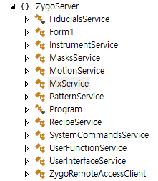
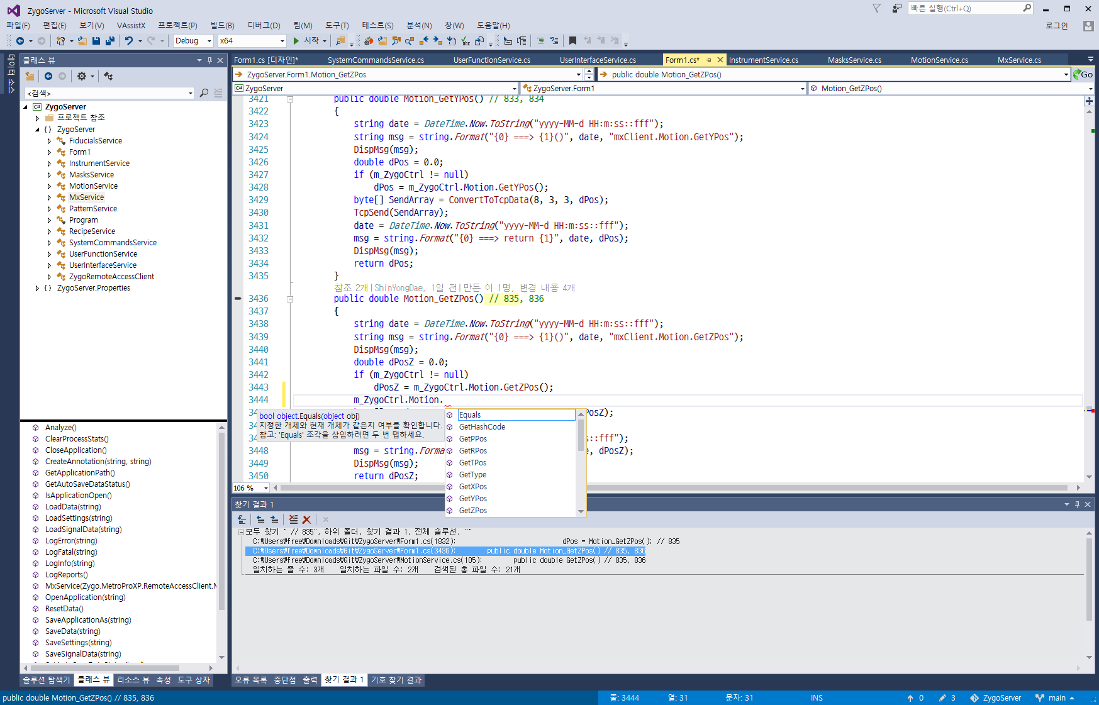
C#용 Class Library (Zygo Server)

Slide 57
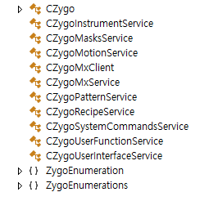
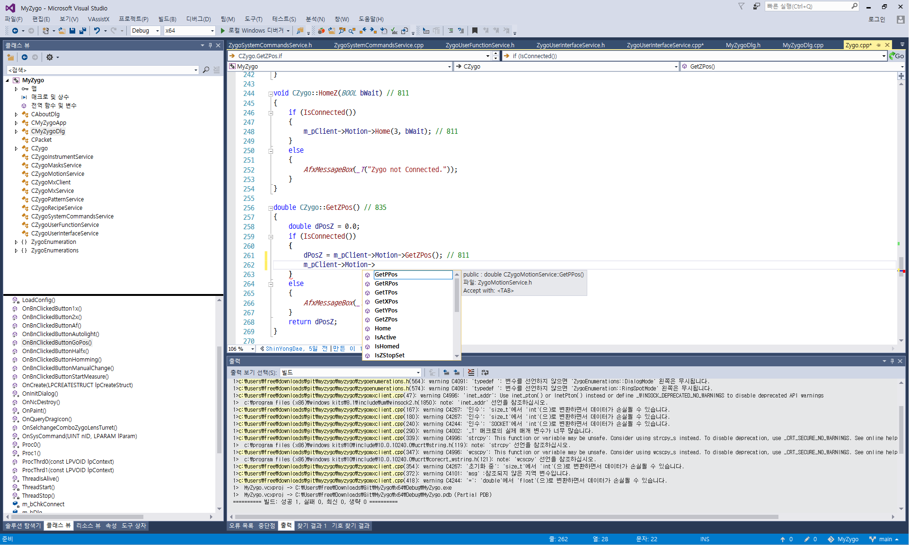
MFC용 Class Library (SSR5 Client)

Slide 58
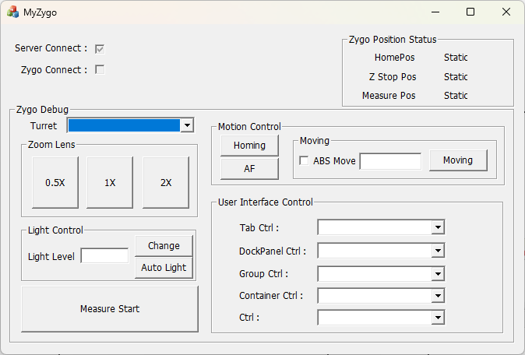
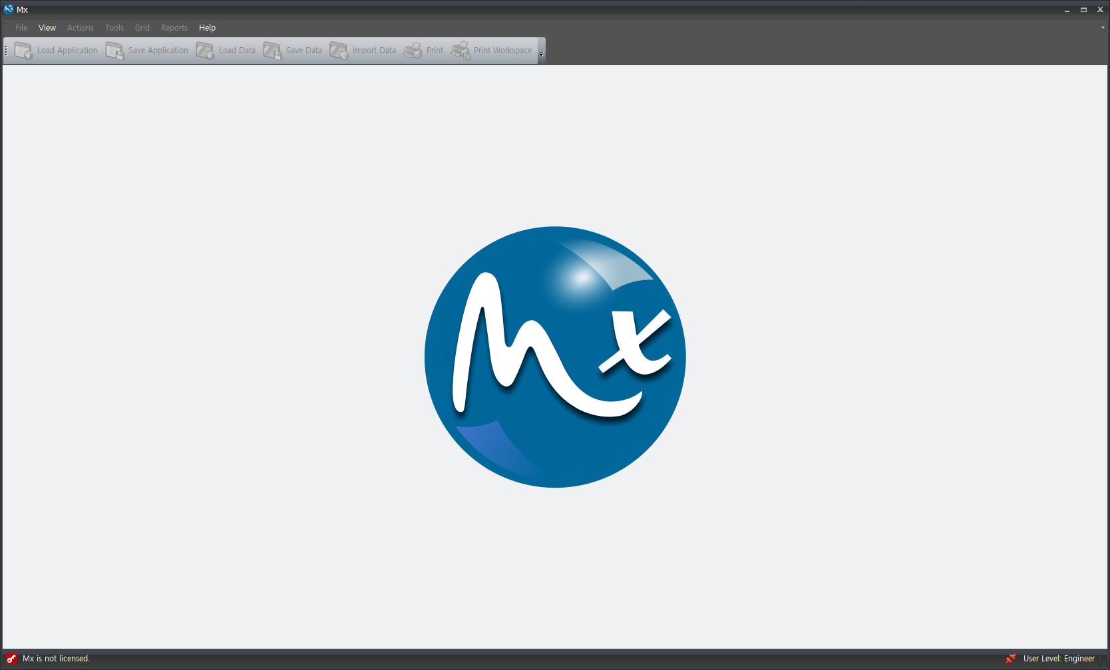
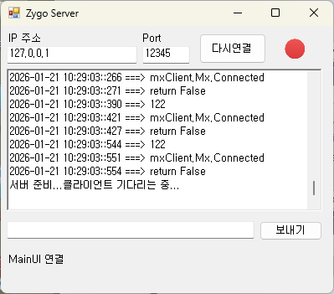
프로그램 연결 구성
TCP
Zygo.MetroProXP.RemoteAccessClient.dll for C#
C++
MainUI.exe
C#
Client
Server
Client
Server
약 : 50 [mSec]
SSR5 PC
Zygo PC

Slide 59
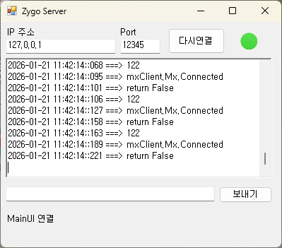
SSR5와 Zygo간 명령/응답 속도
127 – 95 = 32 [mSec]
189 – 127 = 65 [mSec]
약 : 50 [mSec]

Slide 60
타입캐스트
reinterpret_cast<new_type>(expression)
InterlockedExchangePointer

Slide 61
reinterpret_cast<new_type>(expression)

Slide 62
Zygo 3D Data
2026.02.24
신 용 대

Slide 63
xyz Format
header and measurement data
The parts are separated by sharp (#) character.
XYZ Pixel Resolution
#
Phase Data

Slide 64
XYZ Pixel Resolution
the eighth line of the header
CameraRes : meters/pixel
The horizontal and vertical pixel resolution :
CameraRes = 1.81512e-005
To get microns (10-6 meters): (.000018512)*(1000000) = 18.512 microns.

Slide 65
Phase Data
Each line contains three pieces of data.
column (y) , row (x) , “No Data” or measurement in microns.
Column/Row/Height Data

Slide 66
example
Zygo XYZ Data File - Format 1
0 8 0 0 " “ // Minor-Version, Major-Version, Bug-Version, Type
0 0 0 0 0 0
0 0 1600 1200 // Start-Index-Column, Start-Index-Row, Total-Columns, Total-Rows
" "
" "
" "
0 0.5 5.89549e-07 0.55 1 0 9.02568e-08 1763688307 // Group-Number, Scale-Factor, Wave-Length-Horizontal[M], Aperture-Number, , , Resolution(Wave-Length-Vertical[M]), Time-Stamp
1600 1200 0 0 87200 0 " “ // Camer-Width, Camera-Height, , , System-Serial-Number,
0 0 0 0 0 0 0 73.93 0 0 // , , , , , , , Light-Level-Percent, ,
1 1 0 0 0 0 0 0 0
0 " "
1 0
#
0 0 16.41225
1 0 16.345756
2 0 16.308048
.
.
.
1598 1199 15.255566
1599 1199 15.255357
#

Slide 67
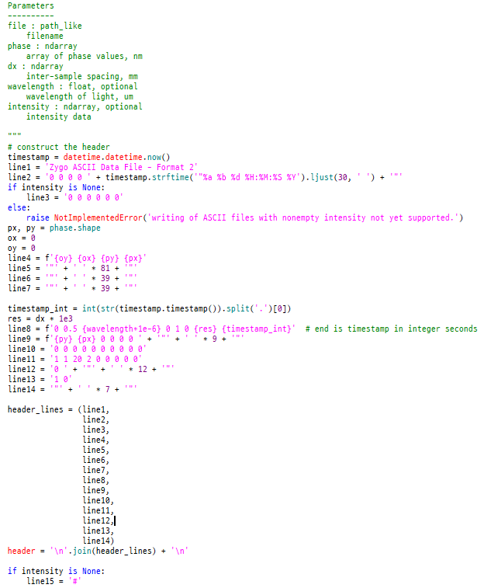
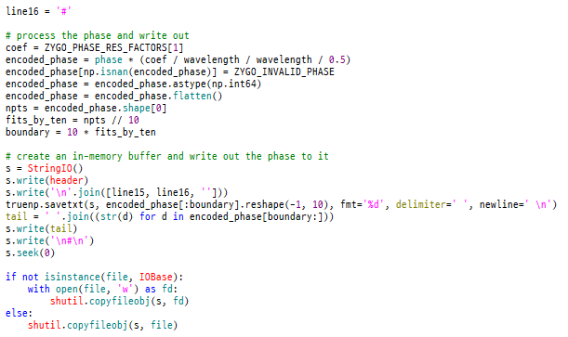
ASCII파일(.xyz) 구조

Slide 68
Datx File이란?
.DATX 파일은 주로 과학, 공학 또는 측정 데이터 수집에 사용되는 바이너리 데이터 저장 파일
특히 DSPCon 과 activPAL 에서 많이 사용됩니다.
이러한 파일에는 채널 이름 및 단위와 같은 메타데이터를 포함하는 대규모 자체 문서화 데이터 세트가 포함되는 경우가 많습니다.
일반적인 사용 사례로는 Zygo 계측 3D 데이터 , DewesoftX 분석 및 Biotage Isolera 화학 로그 등이 있습니다 .

Slide 69
Datx 파일
목적:
이 파일들은 후처리 및 분석을 위한 가공되지 않은 원본 데이터를 저장
호환성:
특정 소프트웨어에서만 지원
Zygo Mx, APEX, MATLAB(h5read를 통해), PALanalysis, …
구조:
HDF5 기반이거나 독자적인 바이너리 형식

Slide 70
HDF5 ( Hierarchical Data Format)
그룹(Group), 데이터셋(Dataset), 속성(attribute)
그룹=디렉토리, 데이터셋=파일
속성은 사용자가 정의하는 일종의 메타데이터
그룹이나 데이터셋을 부연 설명함
운영체계와 무관
대용량 데이터를 빠르게 읽고 쓸 수 있다.

Slide 71
HDF5 간단한 예
# write
f = h5py.File('weather.hdf5','w') # 'a'
f.attrs['descr'] = 'Temperature and wind data at HK mall'
f['/15/temperature'] = temperature15
f['/15/temperature'].attrs['dt'] = 10.0
f['/15/temperature'].attrs['start_time'] = 1375204299
f['/15/wind'] = wind15
f['/15/wind'].attrs['dt'] = 5.0
f['/20/temperature'] = temperature20
f['/20/temperature'].attrs['dt'] = 10.0
f['/20/temperature'].attrs['start_time'] = 1375204299
f['/20/wind'] = wind20
f['/20/wind'].attrs['dt'] = 5.0
f.close()
# read
f = h5py.File('weather.hdf5','r')
temp = f['15/temperature'][:]
dt = f['15/temperature'].attrs['dt']
f.close()

Slide 72
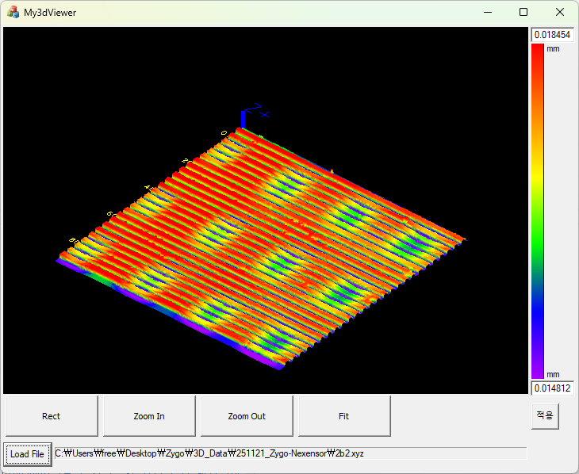
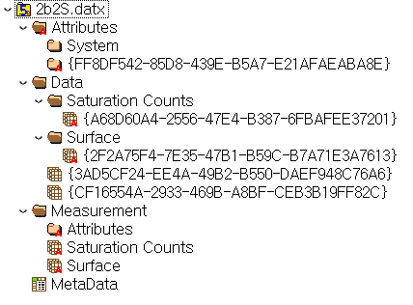
Zygo datx format
Group “/”
Group “Attributes”
ATTRIBUTE
DATATYPE
DATASPACE
DATA
Group “System”
Group “FF8DF542-85D8-439E-B5A7-E21AFAEABA8E”
ATTRIBUTE "Data Context.Data Attributes.AGC"
DATATYPE
DATASPACE
DATA
ATTRIBUTE "Data Context.Data Attributes.Acquisition Mode“
.
.
.
Group “Data”
Group “Saturation Counts”
DataSet “{A68D60A4-2556-47E4-B387-6FBAFEE37201}”
DATATYPE H5T_STD_I32LE
DATASPACE SIMPLE { ( 1200, 1600 ) / ( 1200, 1600 ) }
DATA {
(0,0): 0, 0, 0, 0, 0, 0, 0, 0, 0, 0, 0, 0, 0, 0, 0, 0, 0, 0, 0,
(0,19): 0, 0, 0, 0, 0, 0, 0, 0, 0, 0, 0, 0, 0, 0, 0, 0, 0, 0, 0,
.
.
.
(0,1583): 0, 0, 0, 0, 0, 0, 0, 0, 0, 0, 0, 0, 0, 0, 0, 0, 0,
(1,0): 0, 0, 0, 0, 0, 0, 0, 0, 0, 0, 0, 0, 0, 0, 0, 0, 0, 0, 0,

Slide 73
Reading Zygo DATX with C++ & HDF5
Library Installation
#include "H5Cpp.h"
Open the File
H5::H5File file(filename, H5F_ACC_RDONLY);
Access Data
DataSet dataset = file.openDataSet("/Data/Surface/{2F2A75F4-7E35-47B1-B59C-B7A71E3A7613}");
Read Data
dataset.read(data_out, PredType::NATIVE_FLOAT);

Slide 74
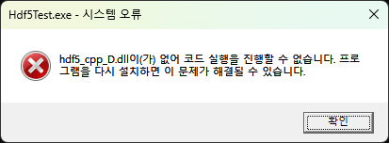
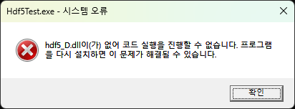
포함 DLL
dynlibadd_D.lib
dynlibcopy_D.lib
dynlibdiff_D.lib
dynlibdump_D.lib
dynlibls_D.lib
dynlibvers_D.lib
filter_plugin1_dsets_D.lib
filter_plugin2_dsets_D.lib
filter_plugin3_dsets_D.lib
filter_plugin4_groups_D.lib
libhdf5_cpp_D.lib
libhdf5_D.lib
libhdf5_hl_cpp_D.lib
libhdf5_hl_D.lib
libhdf5_test_D.lib
libhdf5_tools_D.lib
null_vol_connector_D.lib

Slide 75
SSR 3D Viewer
2026.03.06
신 용 대

Slide 76
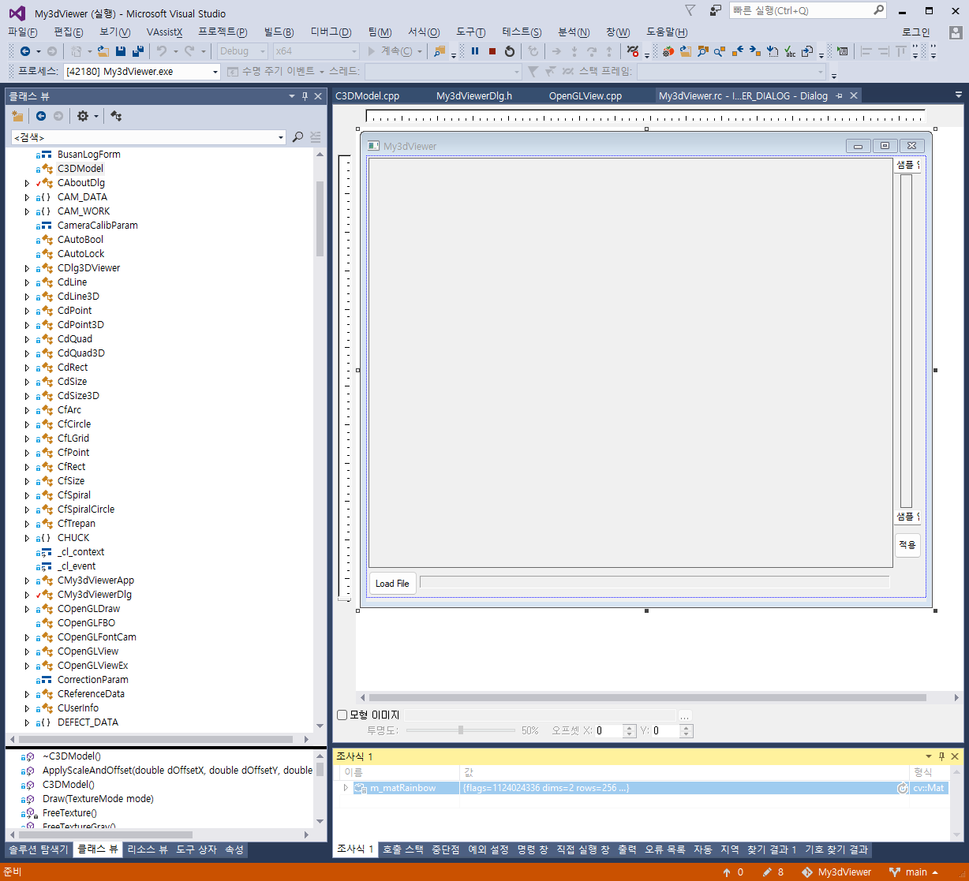
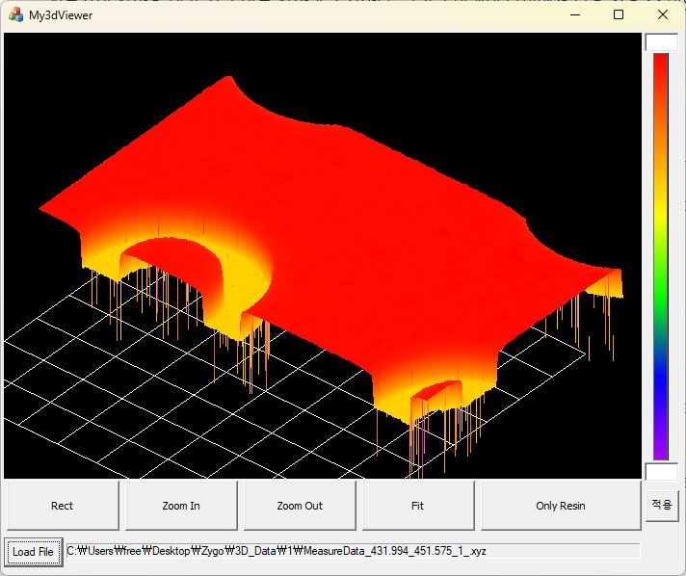
측정된 3D 데이터 뷰어

Slide 77
VS2015 개발환경 추가 설정
실행 가능 디렉터리
C:\hdf5\hdf5-1.14.6\build\bin\Debug
C:\hdf5\hdf5-1.14.6\build\bin\Release
포함 디렉터리
C:\hdf5\hdf5-1.14.6\src
C:\hdf5\hdf5-1.14.6\build\src
C:\hdf5\hdf5-1.14.6\src\cpp\src
C:\hdf5\hdf5-1.14.6\src\H5FDsubfiling
전처리기 정의
_AFXDLL
H5_BUILT_AS_DYNAMIC_LIB
라이브러리 디렉터리
C:\hdf5\hdf5-1.14.6\build\bin\Debug
C:\hdf5\hdf5-1.14.6\build\bin\Release
추가 종속성
hdf5_D.lib
hdf5_cpp_D.lib
hdf5.lib
hdf5_cpp.lib

Slide 78
3D Rendering 순서
ExtractInfo(sPath)
Display3D()
cv::Mat dst = m_cMatching.ApplyConvertImageAuto(matModelIMG);
m_cMatching.GetMinMax(m_fMin, m_fMax);
applyColorMap(dst, dst2, cv::COLORMAP_RAINBOW);
m_DefectColor = dst2;
cv::resize(dst2, m_Image, cv::Size(rectResult.Width(), rectResult.Height()));
DrawMat(pDCResult->m_hDC, m_Image);
::SetDIBitsToDevice(hDC, .., img.data, ..);
OnUpdate3DModel(WPARAM wParam, LPARAM lParam)
m_Model.m_ZMap = m_matrixZ.clone();
m_Model.MakeModel();
for (y = 0; y < m_ZMap.rows - 1; y++)
for (x = 0; x < m_ZMap.cols - 1; x++) m_triangles.push_back(tri);
LoadTexture(m_ColorImg);
m_bTextureLoaded = 1;
yScale = 1000.0 / (double)S3DData->m_matDepthMap.rows;
xScale = 1000.0 / (double)S3DData->m_matDepthMap.cols;
m_Model.ApplyScaleAndOffset(0, 0, 0, xScale, yScale, 5000);
((COpenGLViewEx*)m_pView)->Refresh();
GLRenderScene(WM_FIT_TO_SCREEN);
m_pParentWnd->SendMessage(WM_USER_RENDER, m_nHandleID, nAction);
OnGLRender(WPARAM wParam, LPARAM lParam)
glRotated(_angleVer, 1, 0, 0); glRotated(_angleHor, 0, 0, 1); glTranslatef(-600, -200, 100);
m_draw.DrawAxisXYZ(0, 0, 0, 150, 5);
m_draw.DrawGrid(10, 10, 100, 100, 0, 0, 5, 5, CdPoint3D(0, 0, 0), G_GRID_TEXT, RGB_RED);
if (m_Model.m_bMeshCreated) m_Model.Draw(TEX_LUT);
int nSize = m_triangles.size();
glBindTexture(GL_TEXTURE_2D, m_Texture);
for (int i = 0; i < nSize; i++)
stTagTriangles tri = m_triangles[i];
for (int i = 0; i < nSize; i++) glVertex3f(tri.x[k], tri.y[k], tri.z[k]);
glBindTexture(GL_TEXTURE_2D, 0);

Slide 79
OpenGL Event 처리
m_pView = new COpenGLViewEx();
void COpenGLView::GLRenderScene(UINT nAction=0, int nKey=0)
m_pParentWnd->SendMessage(WM_USER_RENDER, m_nHandleID, nAction);
m_nHandleID : IDC_STATIC_VIEW
nAction :
WM_MOUSEWHEEL, WM_PAINT, WM_FIT_TO_SCREEN,
WM_LBUTTONDOWN, WM_MOUSEMOVE, WM_LBUTTONUP,
WM_MBUTTONDOWN, WM_MBUTTONUP,
WM_RBUTTONDOWN, WM_RBUTTONUP
LRESULT CDlg3DViewer::OnGLRender(WPARAM wParam, LPARAM lParam)
if (lParam == WM_LBUTTONDOWN) _mouseDownPoint = m_pView->m_ptCurPos;
else if (lParam == WM_LBUTTONUP) _mouseDownPoint = CPoint(0, 0);
else if (lParam == WM_RBUTTONDOWN) _mouseDownPoint = m_pView->m_ptCurPos;
else if (lParam == WM_RBUTTONUP) _mouseDownPoint = CPoint(0, 0);
else if (lParam == WM_MOUSEHWHEEL) m_pView->ZoomIn(1.1); m_pView->ZoomOut(1.1);
else if (lParam == WM_MOUSEMOVE)
if (_mouseButton == 1) Rotate // lParam == WM_LBUTTONDOWN
else if (_mouseButton == 2) Transiant // lParam == WM_RBUTTONDOWN
else if (_mouseButton == 3) ?
_mouseDownPoint = m_pView->m_ptCurPos;

Slide 80
Zygo Mx
2026.03.11
신 용 대

Slide 81
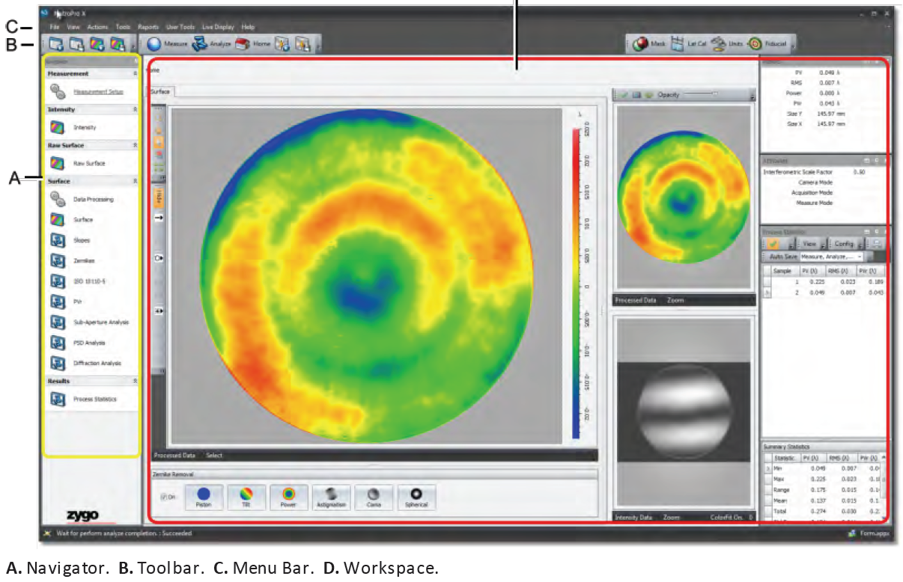
User Interface

